Slide 1
Connecting Tables

Slide 2
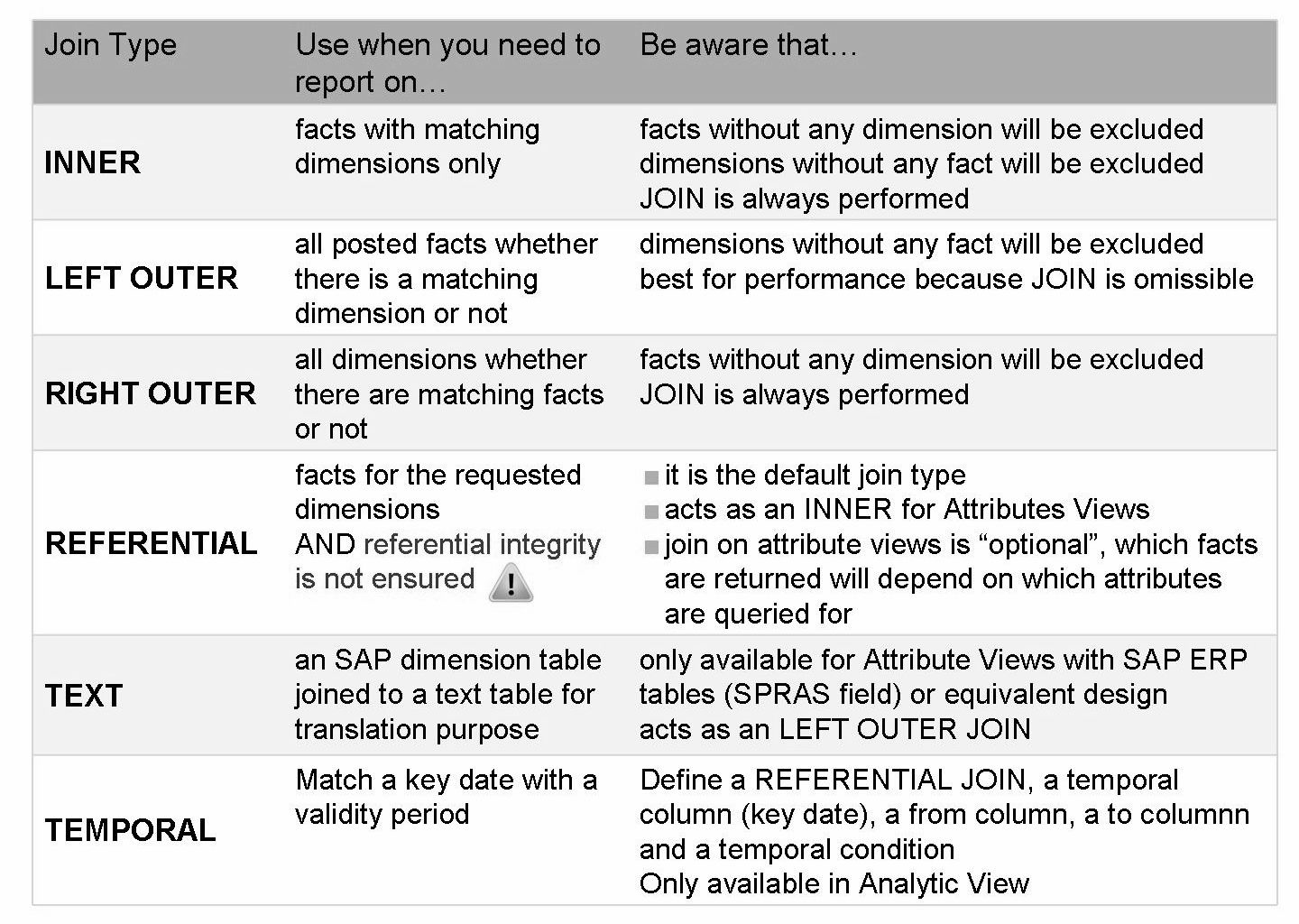
Join Types – Definitions

Slide 3
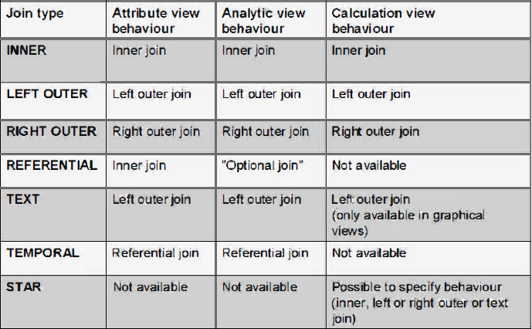
Join Behavior in Different Information Models

Slide 4
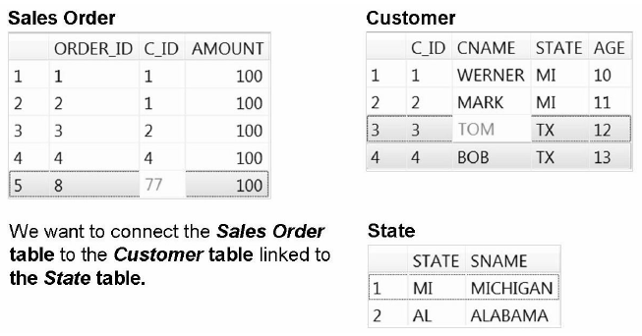
Business Example
Order 8 does not have a customer master record.
Customer TOM does not have any orders.
State TX does not have a description.
No customer resides in Alabama.

Slide 5
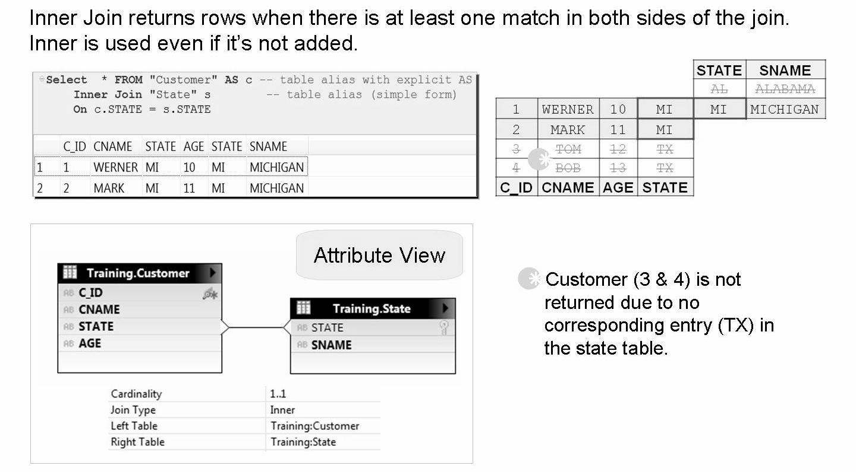
Inner Join - Attribute View

Slide 6
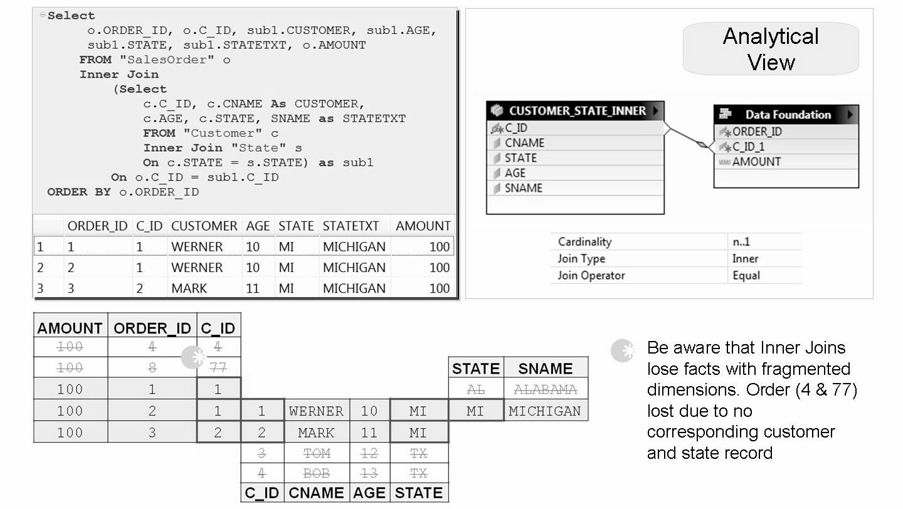
Inner Join - Analytical View

Slide 7
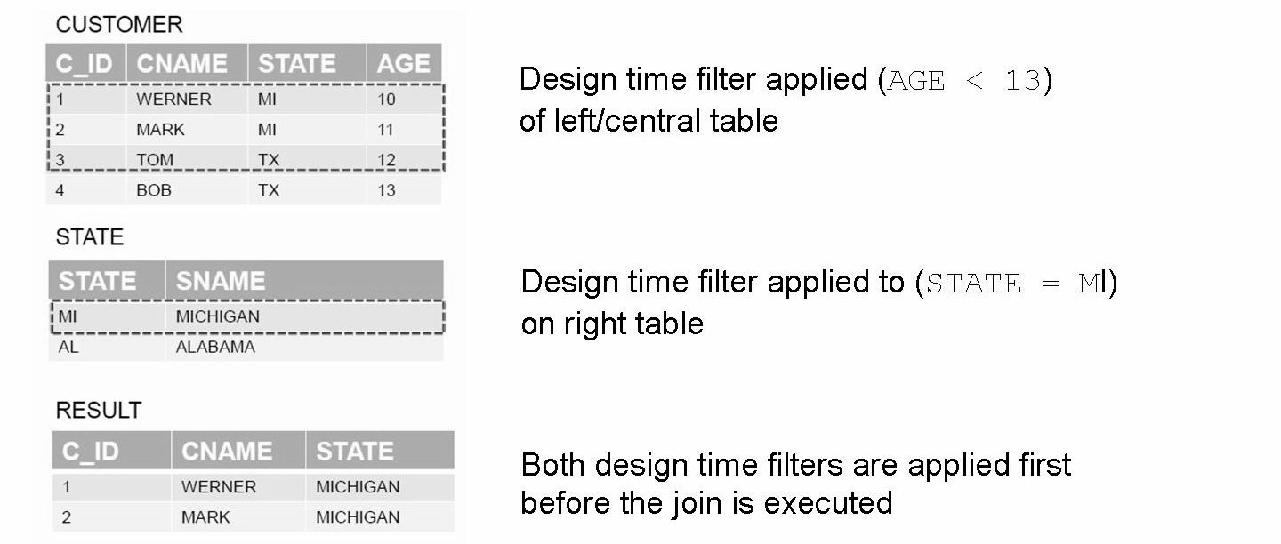
Inner Join and Design Time Filters

Slide 8
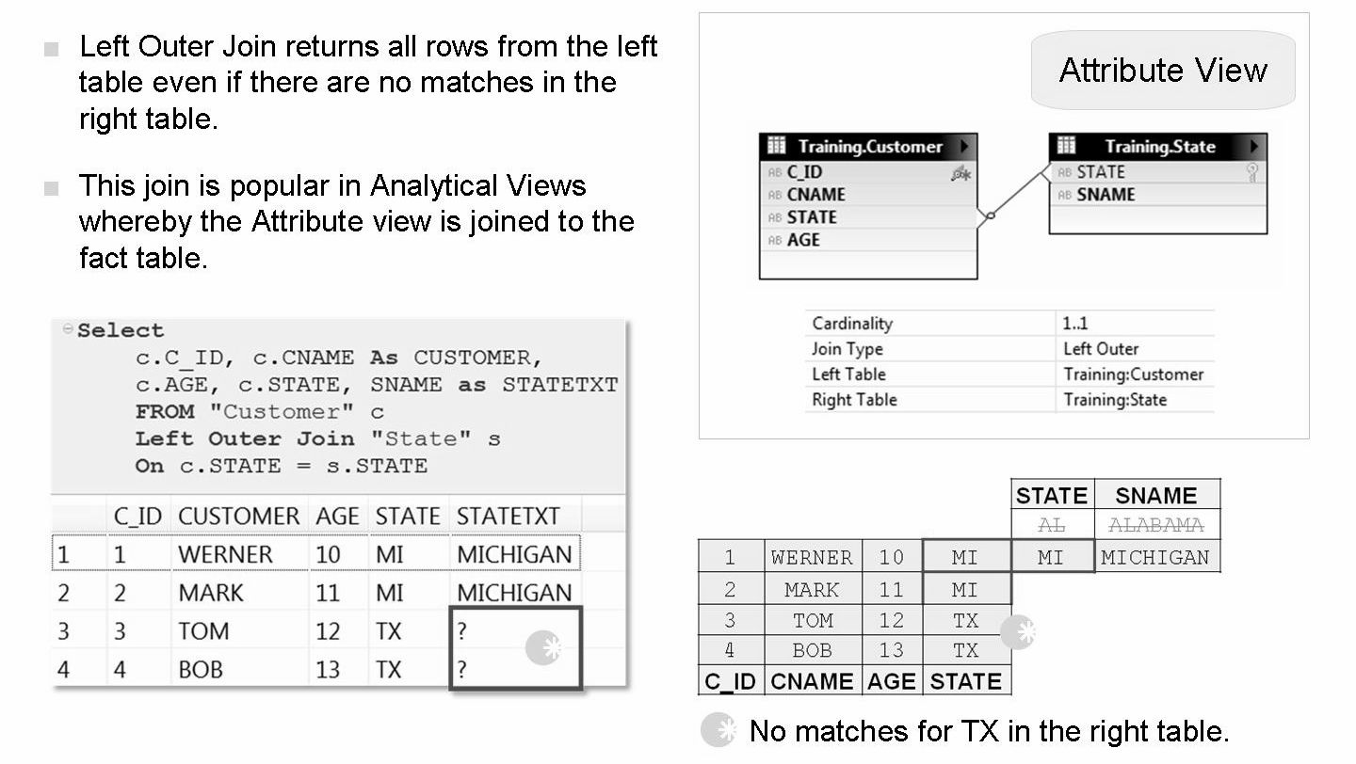
Left Outer Join - Attribute View

Slide 9
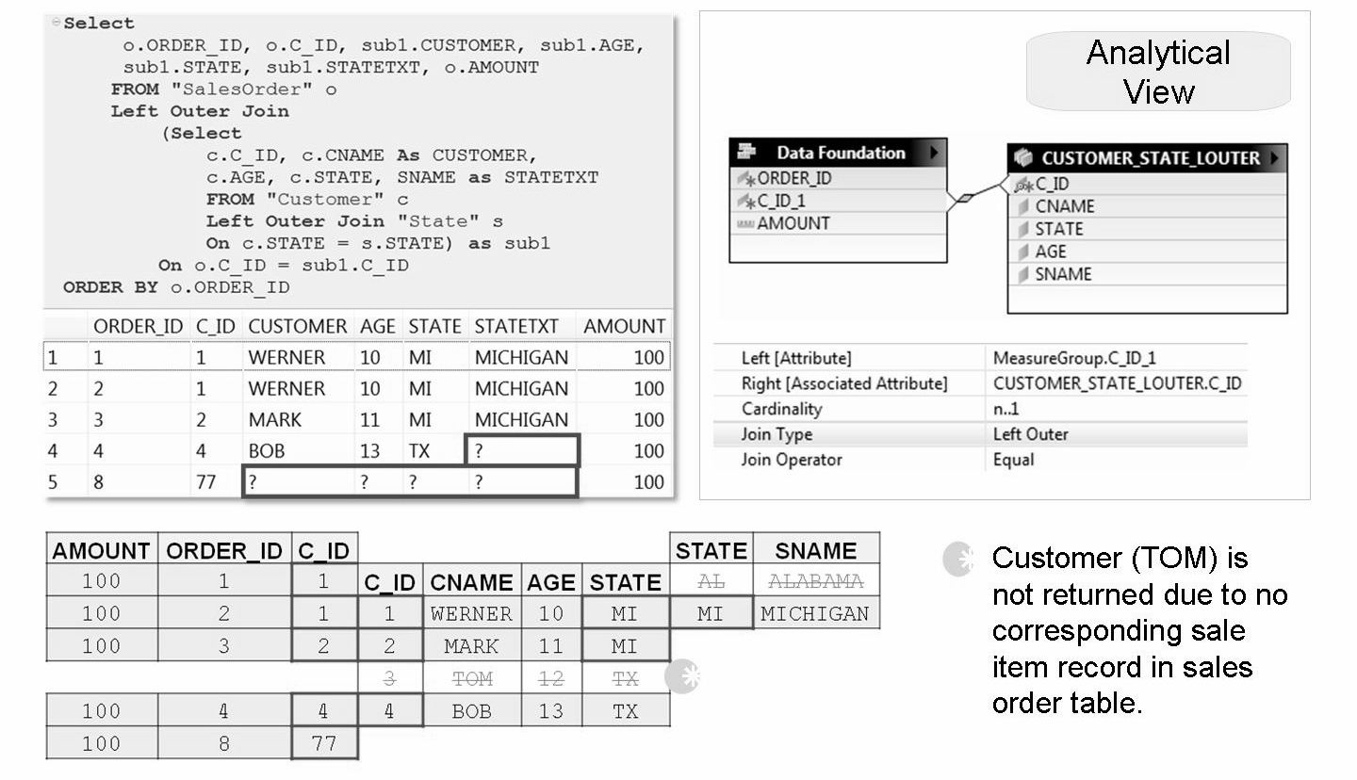
Left Outer Join - Analytical View

Slide 10
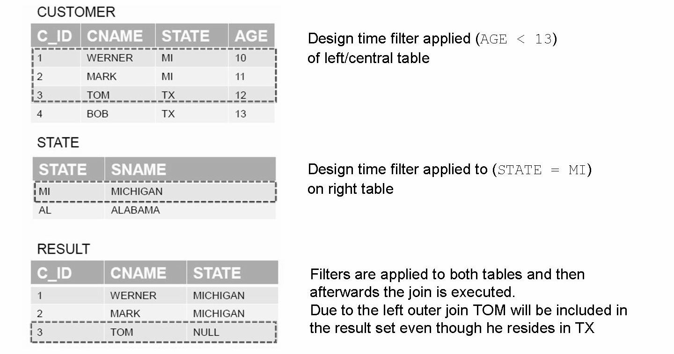
Left Outer Join and Design Time Filters

Slide 11
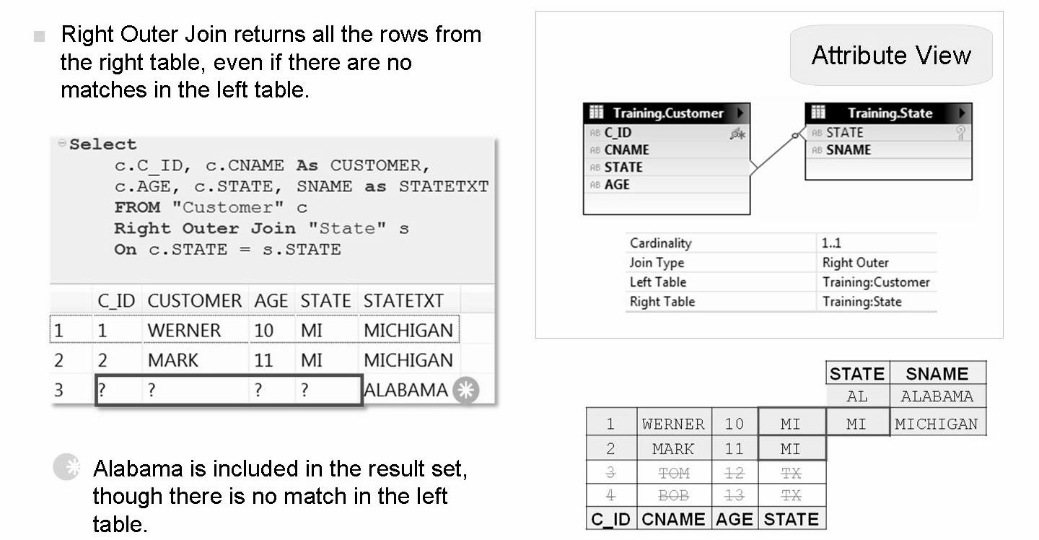
Right Outer Join - Attribute View
Right outer join is rarely used
the number of records in the result set is determined by the number of records in the right table
If there is a 1:n relationship the number of records can be greater that the number of records in the left table

Slide 12
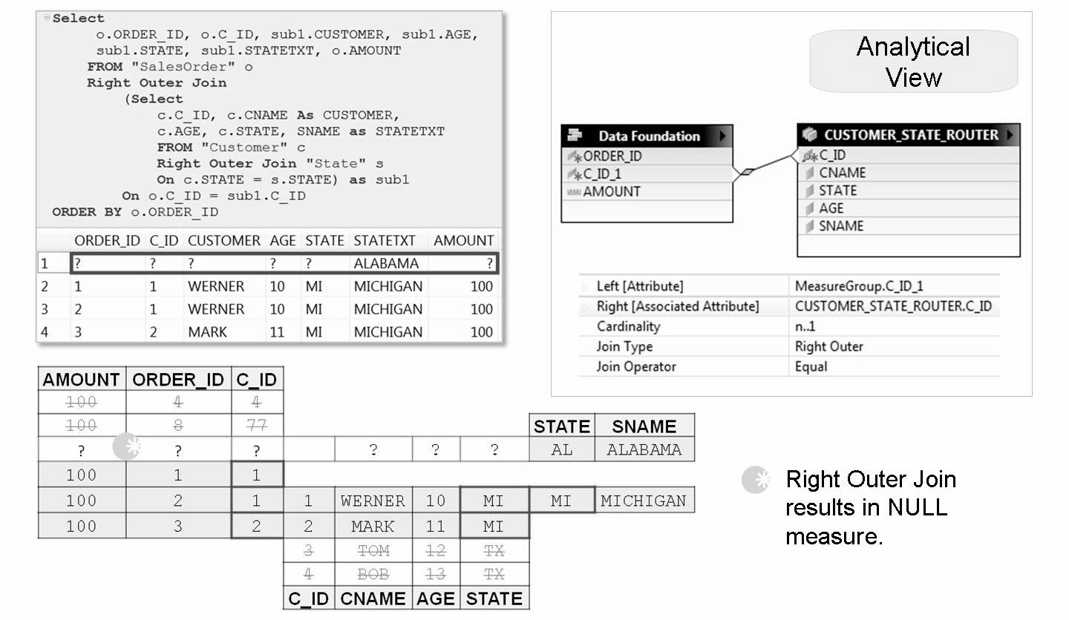
Right Outer Join - Analytical View

Slide 13
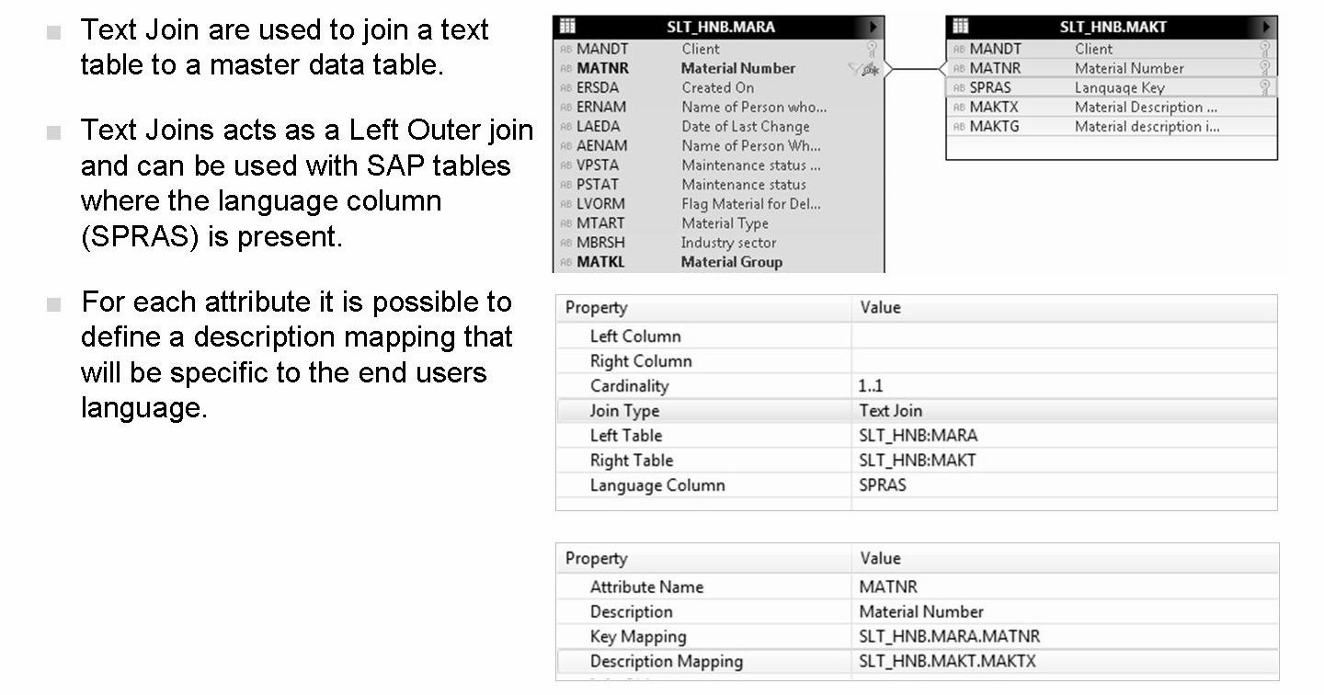
Text Join for multilingual reporting
Text join is used when a translation for a dimension is available
Designed for ERP tables (and typically SPRAS column)
User language is used as a filter at runtime to find the right translation for that attribute

Slide 14
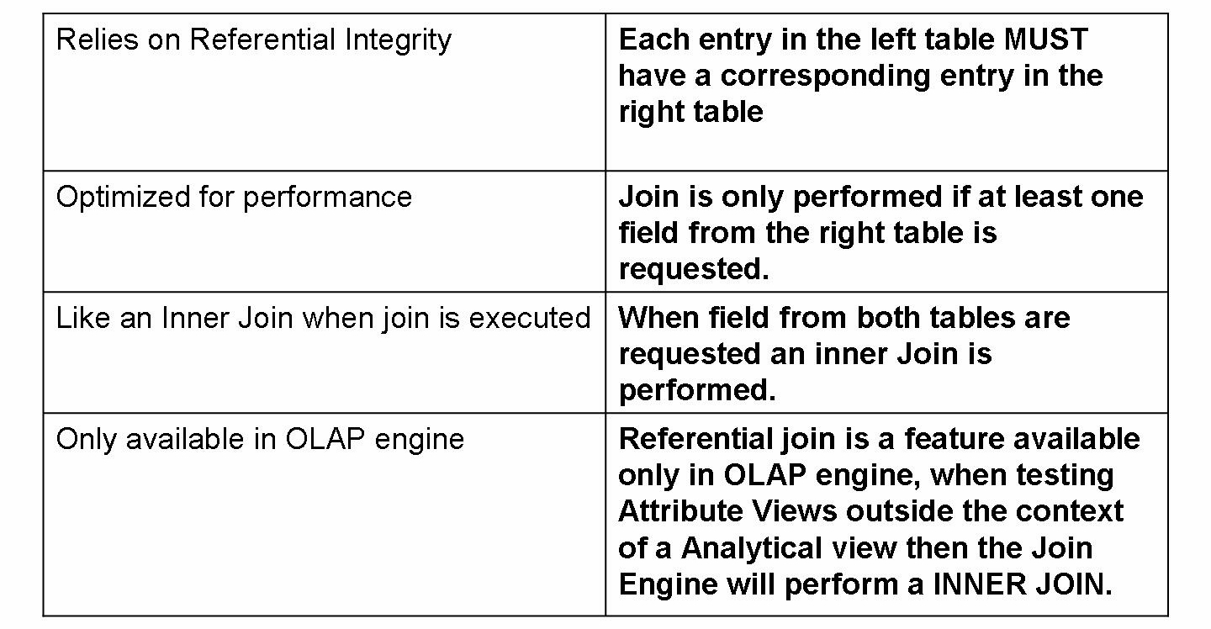
Referential Join

Slide 15
Is semantically a inner join that assume that referential integrity is given which means that the left table always have an corresponding entry on the right table
It could be used in e.g. data foundation for header-item relations where it can be assumed that for each item a header exists
It can be seen as an optimized or faster inner join where the right table is not checked if no field from the right table is requested
That means that the Referential Joins will be only executed, when fields from both tables are requested
if a field is selected from the right table it will act similar to inner join, and if no fields from the right table is selected it will act similar to a left outer join
Referential joins should be used with caution since it assumes that referential integrity is ensured.
The only valid scenario for the Referential Join is that
(a) it is 100% guaranteed that for each row in one table, there is at least one join partner in the other table
(b) that holds true in both directions
(c) at all times
If that is not the case then referential joins have the possibility to give incorrect calculations if the referential integrity is not met
From performance perspective, the Left Outer Join are almost equally fast as Referential Join, while the Inner Join is usually slower due to the fact, that the join is always executed
Referential Join cannot be used if a filter is set on a field in both tables.

Slide 16
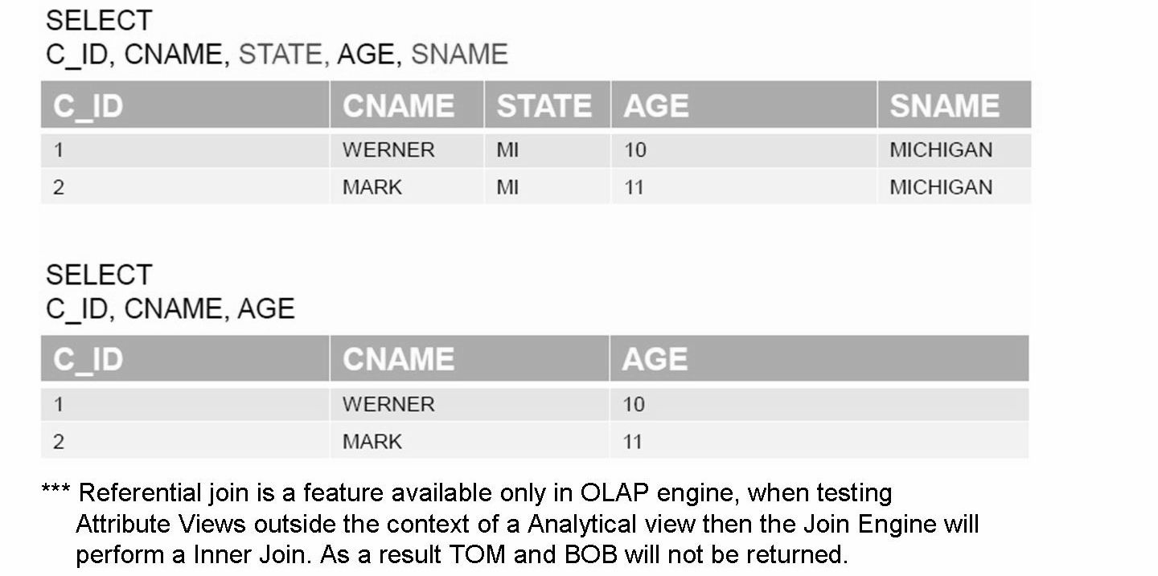
Referential Join - Attribute View

Slide 17
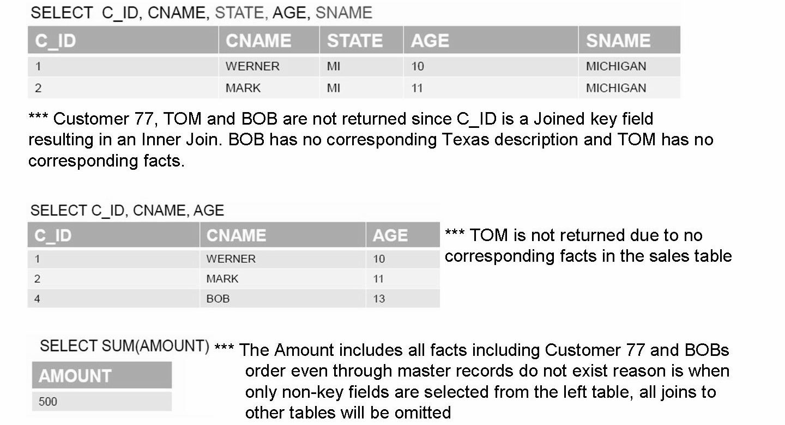
Referential Join - Analytical View

Slide 18
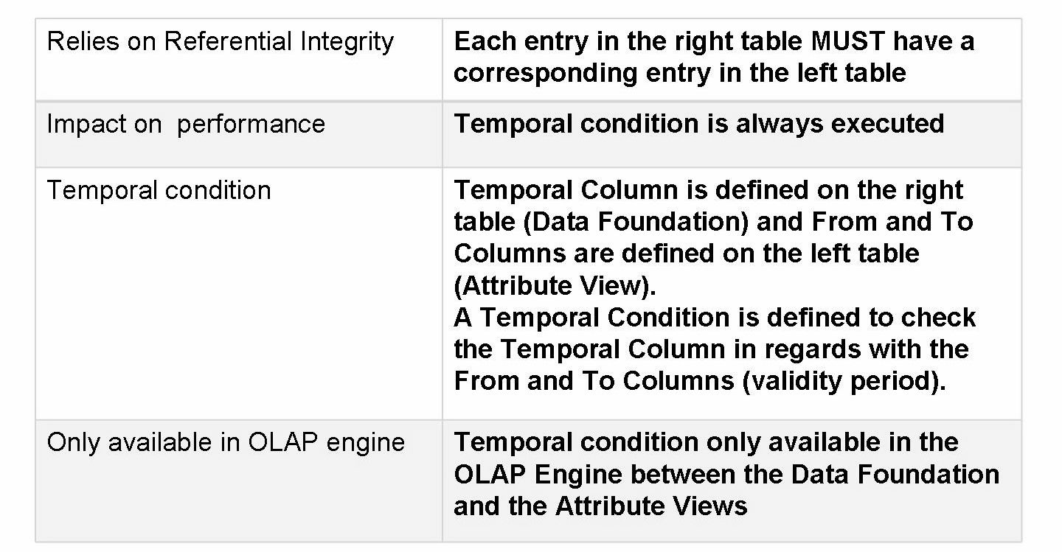
Temporal Join
Despite an impact on performance, Temporal Join are really useful to manage time dependent Attribute Views (Master Data).

Slide 19
Star Join
A star join is only available in calculation views. It is used for data organized in a star schema.
The fact table for a star join can be any type of input node, however only Calculation Views of Data Category Dimension are allowed as input nodes for dimensions.
The type of joins between the fact and dimension tables within the star schema can be defined in the star join node. The available joins are:
Inner join
Left outer join
Right outer join
Text join
Referential Join

Slide 20
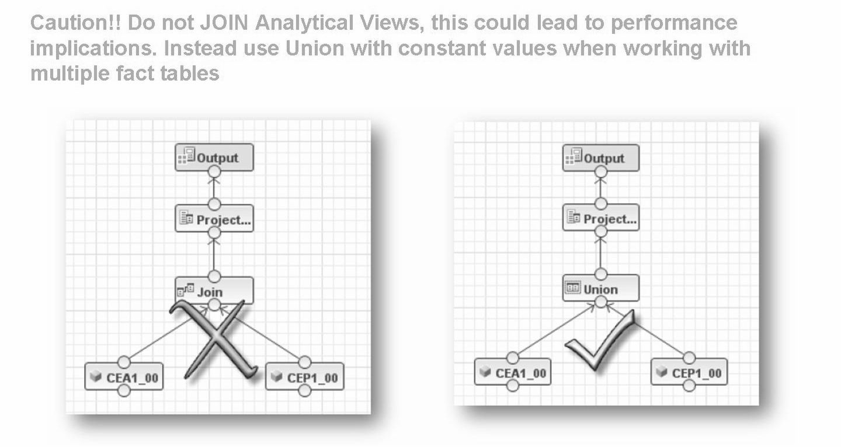
Calculation View - Join vs. Union

Slide 21
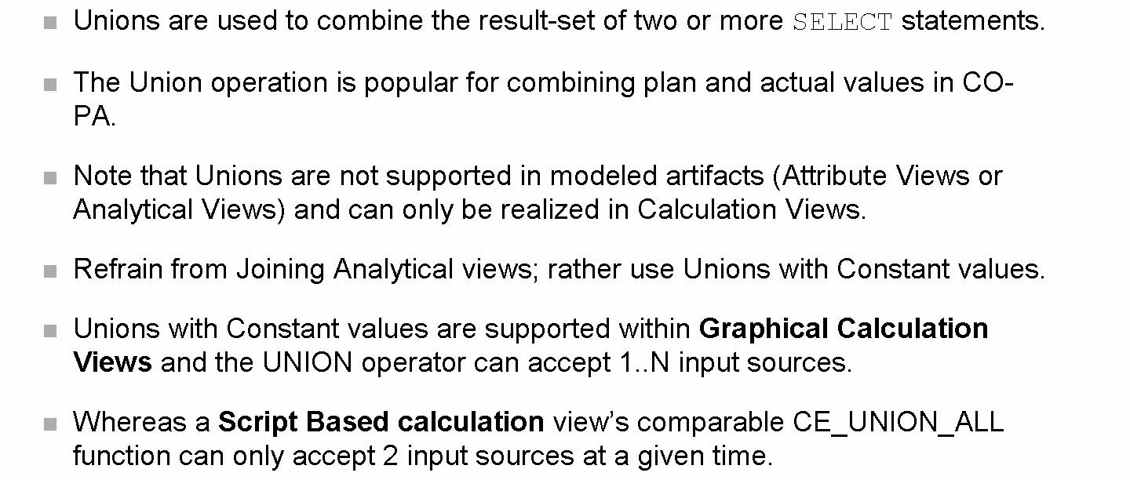
Unions

Slide 22
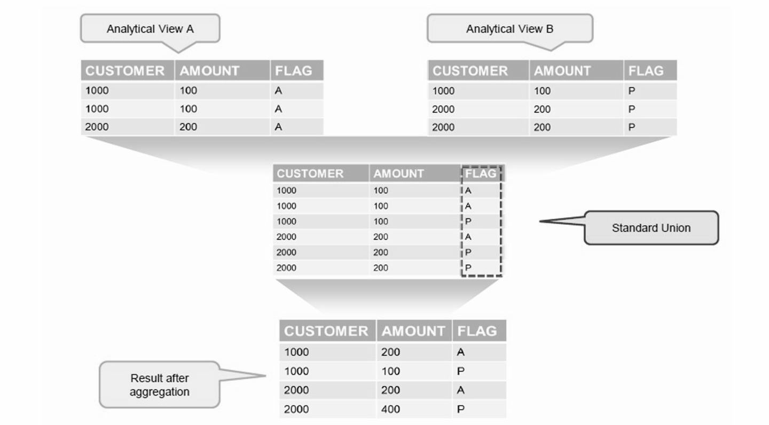
Standard Union

Slide 23
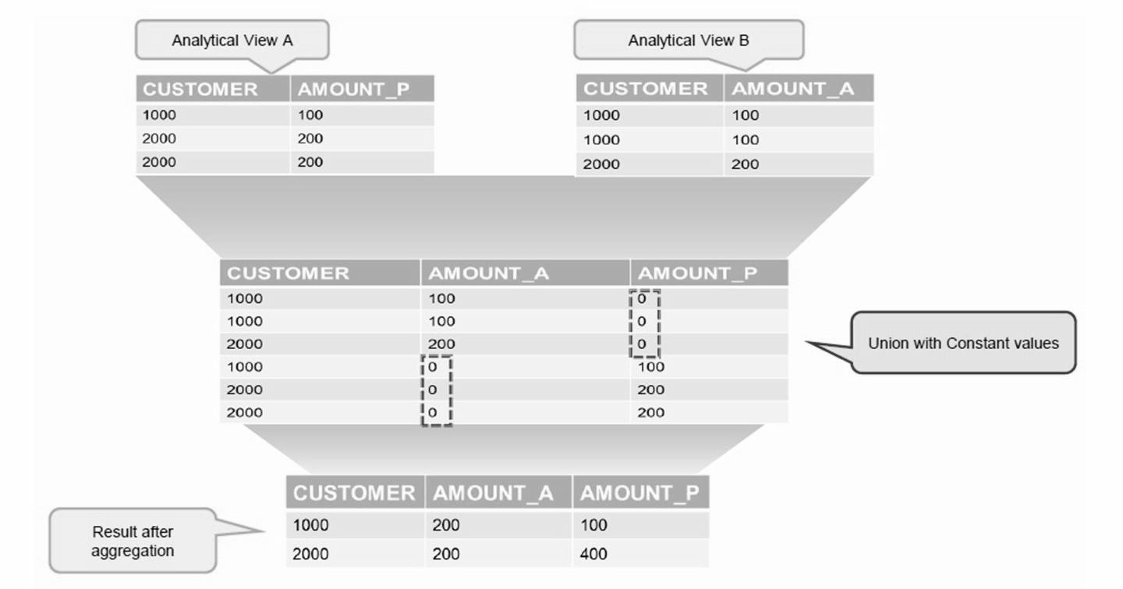
Union with Constant Values

Slide 24
THANK YOU

